Slide 1
Branch Prediction with Graph Analytics
Shubham Hazra 210100143
Om Godage 21D100006
Deepasha 210070025

Slide 2




preDictOrS
Shubham Hazra
(210100143)
Om Godage
(21d100006)
Deepasha
(210070025)

Slide 3
About LTAGE
The TAGE predictor, TAgged GEometric length predictor, relies on several predictor tables indexed through independent functions of the global branch/path history and the branch address. The TAGE predictor uses (partially) tagged components . It relies on (partial) match as the prediction computation function.
TAGE also uses GEometric history length predictor i.e. , the set of used global history lengths forms a geometric series, i.e., . This allows to efficiently capture correlation on recent branch out-comes as well as on very old branches.
LTAGE" refers to "Loop Tagged Architectural Global History", which is a type of branch predictor used in computer processors to predict the outcome of conditional branches, such as if-else statements or loops.

Slide 4
Implementation of L-TAGE
We implemented all three parts, bimodal, TAGE, and loop predictor
We used bitsets to simplify working with bits, and to reduce memory usage
The TAGE part was referenced from the original implementation of Andre Seznec
We used the same hash function, and graceful reset as that suggested by Andre
We used a global history length of 1024 bits, path history length of 16
Smallest history length used is 3
We used a multiplier of 1.7 for the variable history lengths used to index the tables
We reset the useful bits after 256000 branches
A loop table size of 512 was used, and max iterations tracked were 1024

Slide 5

Improvements made for Graph Traces
Decreased confidence threshold for loop predictor
Increased number of components/banks from 12 to 15
Increased size of TAGE predictor counter bits from 3 to 5
Decreased the value of a variable WITHLOOP, which is a score counter, & keeps track of the choice of the predictor
Decreased the maximum age after which loop predictor entries are reset
Changed the number of bits kept for index and tags from that implemented in the paper by observation.
Initialised the bimodal predictor with weakly taken, instead of strongly not taken (as in the default predictor)
https://www.flaticon.com/free-icons/improvement
Notes:
OG implementation never reached threshold, and loop predictor was rarely used, so reducing this allowed its usage
NumComp increase allowed to store larger history lengths,

Slide 6

Insights for Graph Traces
Hash functions are essential in improving the prediction accuracy of the predictor. Earlier we implemented a very simple hash function which caused a lot of collisions and had a very poor performance. We then changed to a better hash function which improved the accuracy significantly.
Loop predictor did not improve performance by much in the original implementation as it was only used when it had maximum confidence which was set to a large value however in graph analytics loops are much more common and reducing the maximum confidence threshold to actually use the loop predictor’s prediction improves performance.

Slide 7
IPC Data
 | TAGE | LTAGE (optimised) | Hashed perceptron
bc-5.trace.gz | 0.203217 | 0.203441 | 0.203561
bfs-8.trace.gz | 0.285778 | 0.287256 | 0.287437
cc-6.trace.gz | 0.186152 | 0.188654 | 0.192665
pr-5.trace.gz | 0.0585784 | 0.0598467 | 0.0581859
sssp-5.trace.gz | 0.303609 | 0.304216 | 0.304591

Slide 8
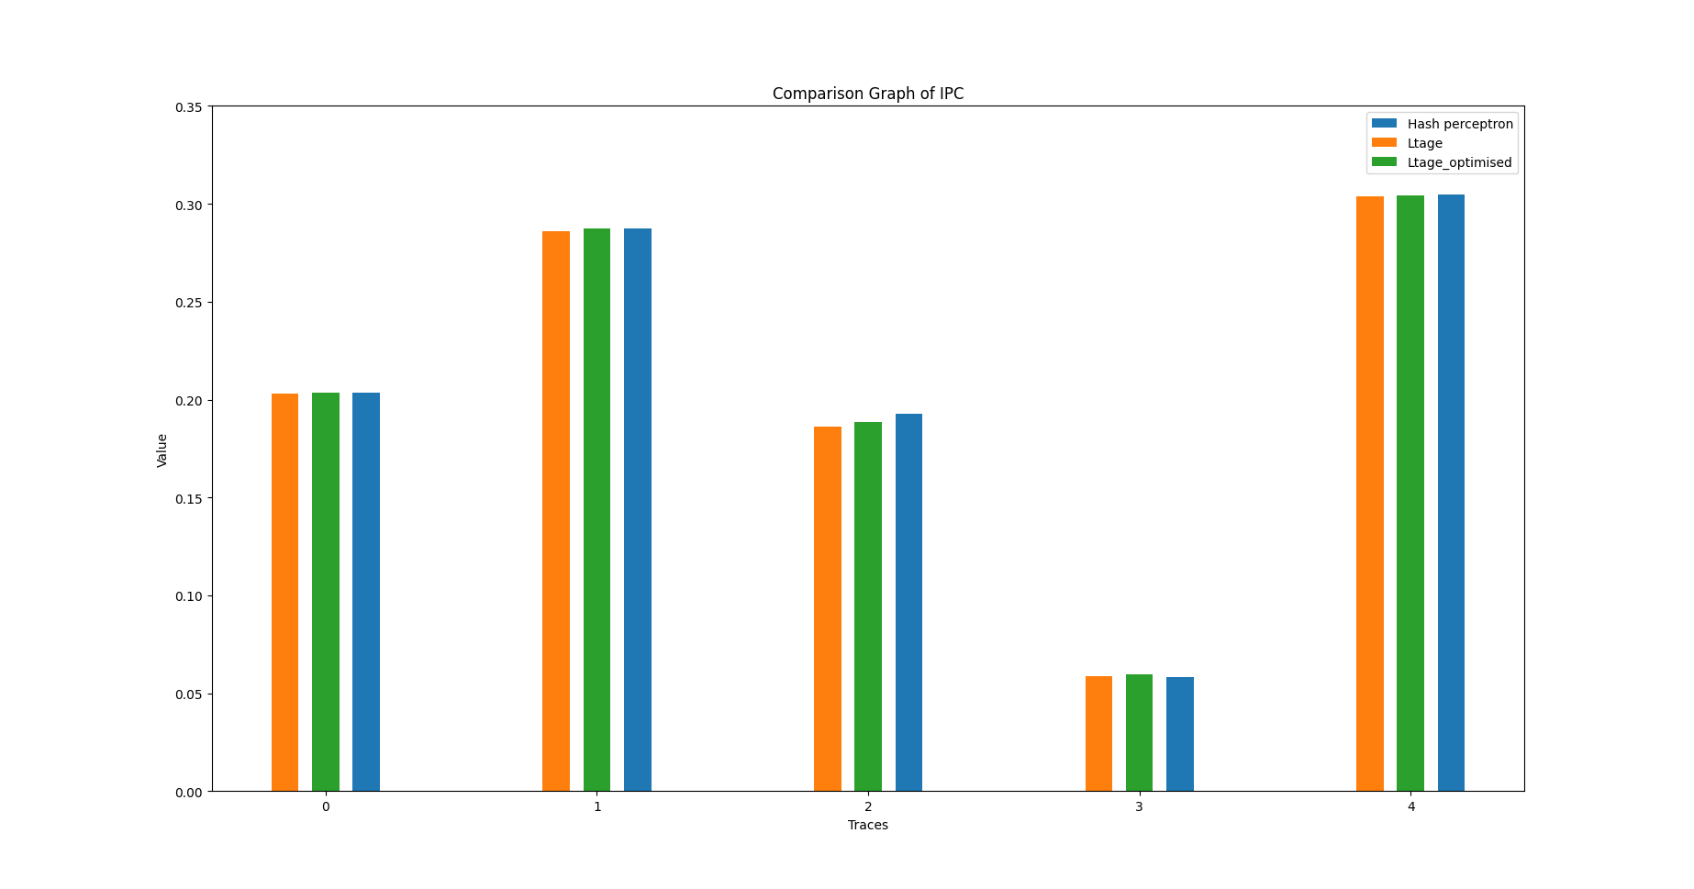

Slide 9
MPKI Data
 | TAGE | LTAGE (optimised) | Hashed perceptron
bc-5.trace.gz | 8.61597 | 8.5823 | 8.58227
bfs-8.trace.gz | 25.3271 | 23.8756 | 23.747
cc-6.trace.gz | 27.3749 | 26.1686 | 24.8772
pr-5.trace.gz | 6.15053 | 6.03533 | 5.96807
sssp-5.trace.gz | 6.89367 | 6.84657 | 6.84413

Slide 10
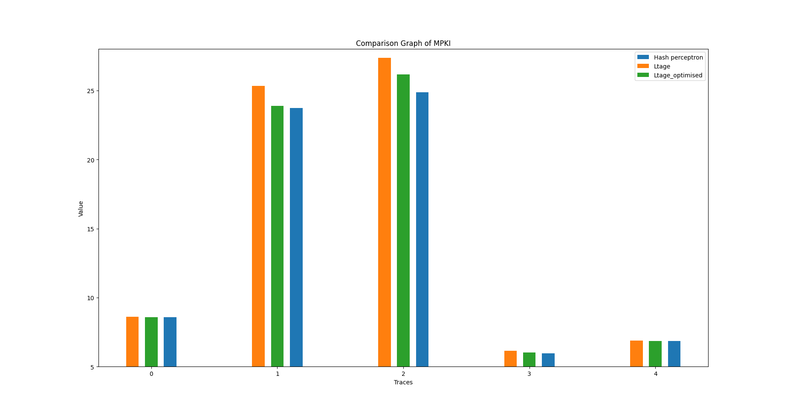
Plot

Slide 11
Branch Prediction Accuracy
 | TAGE | LTAGE (optimised) | Hashed perceptron
bc-5.trace.gz | 93.6329 | 93.6577 | 93.6578
bfs-8.trace.gz | 87.8083 | 88.4995 | 88.5615
cc-6.trace.gz | 86.6572 | 87.2452 | 87.8746
pr-5.trace.gz | 96.7784 | 96.8387 | 96.8739
sssp-5.trace.gz | 95.3293 | 95.3612 | 95.3628

Slide 12
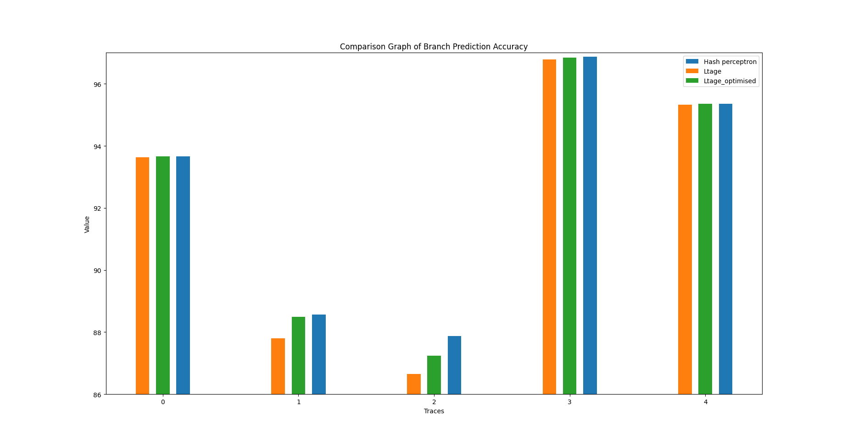

Slide 13
CONCLUSION

Slide 14
THANK YOU !

